Slide 1
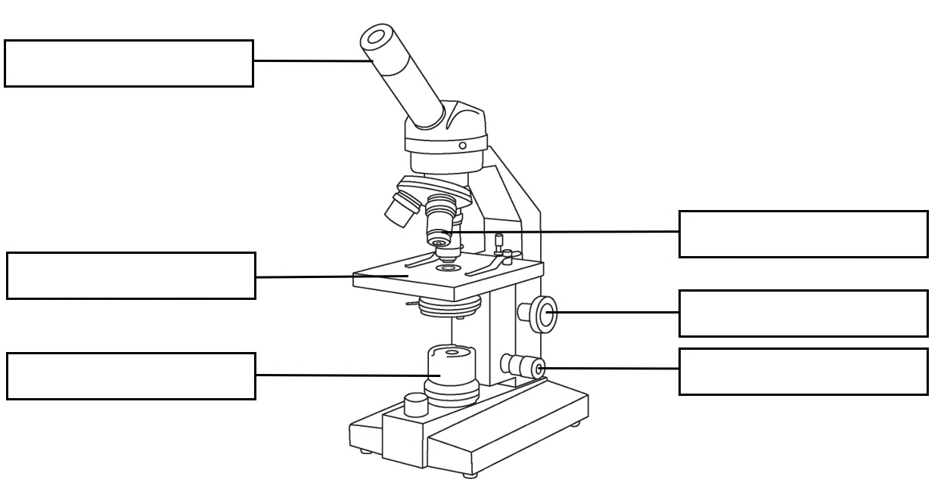
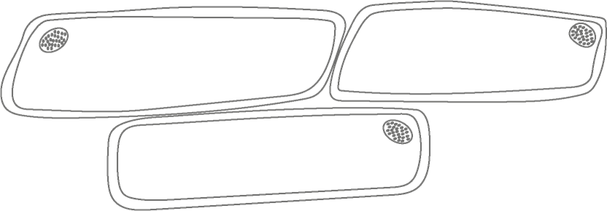
Cells and organisation
The seven common processes of living organisms​
Levels of organisation
Process | Definition
movement | moving itself or its parts to change position or location
reproduction | producing offspring of the same kind
sensitivity | sensing and responding to changes in their surroundings
growth | increasing in size and repairing parts that are damaged
respiration | using oxygen and glucose (a sugar) to provide energy
excretion | removal of waste substances that are no longer needed
nutrition | using food or other nutrients like water to stay alive
cell
tissue
organ
organ system
cell | the smallest living building block of organisms
tissue | a group of similar cells that work together to perform a specific function
organ | a structure made up of different types of tissues that work together to carry out a specific function​
organ system | a group of organs that work together to perform a common function
The parts of the microscope
Using a microscope
Rules for scientific drawings of cells
  Turn the objective lens to the lowest magnification.
  Secure the slide on the stage using the clips.
  Move the stage up to the objective lens by turning the coarse focus.
  Look down the eyepiece lens, and move the stage away by turning the coarse focus.
  To make the image sharper and clearer, turn the fine focus.
  Rotate the objective lens to get a higher magnification.
Drawing of onion cells
eyepiece lens
nucleus
cytoplasm
objective lens
cell wall
stage
cell membrane
coarse focus
10 x 40 = x400
light source
fine focus
  smooth continuous lines
  large, with the same proportions
  stippling
  a few cells
  title and label
  total magnification
total magnification = eyepiece x objective
Science | 7.03 – Cells and organisation | Knowledge organiser
Notes:
Images:
All images – United Learning

Slide 2
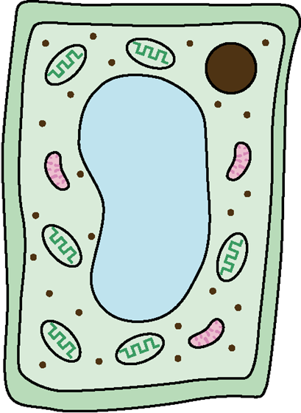
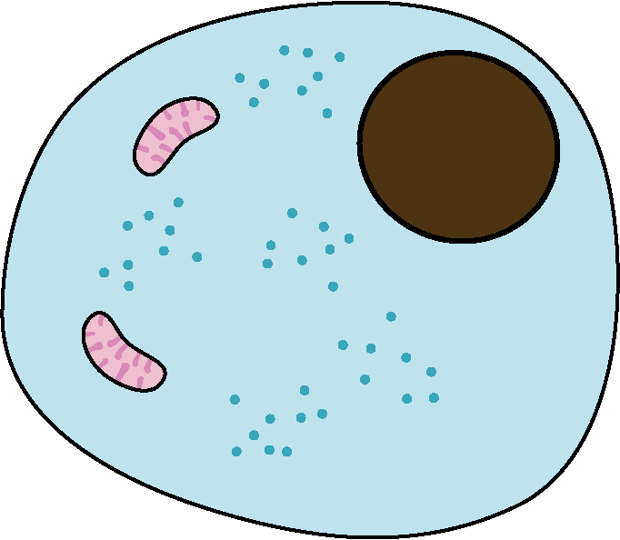
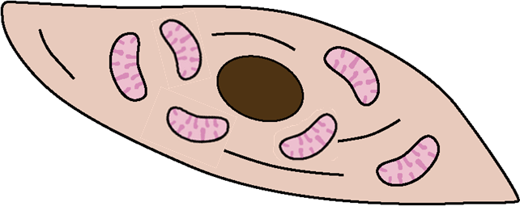
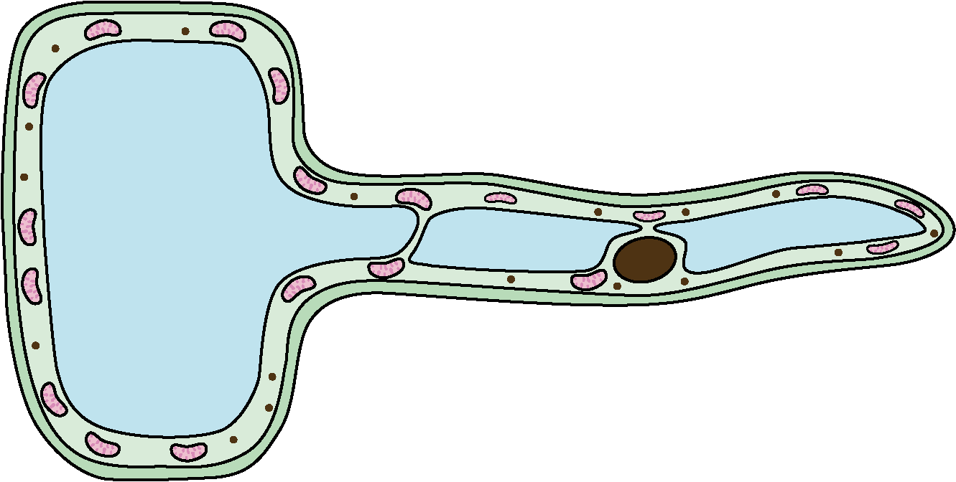

Cells and organisation
Cell organelles and their functions
nucleus | contains the genome that controls the cell’s activities
cytoplasm | where the chemical reactions of the cell take place
mitochondria | where energy is released in respiration
cell membrane | controls which substances enter or leave the cell
vacuole | stores a watery sap
cell wall | strengthen and support the cell
chloroplasts | where light is trapped for photosynthesis to happen
plant cell
animal cell
cell wall
nucleus
mitochondria
vacuole
cytoplasm
chloroplasts
cell membrane
Cells are three dimensional (3D).
The rate of diffusion
Oxygen and glucose (a sugar) are needed for respiration to take place in cells, to provide energy to keep cells alive. These useful substances enter the cell by diffusion. Waste products of respiration are carbon dioxide and water. Waste products leave the cell by diffusion and need to be removed from cells to keep them alive.
  The rate of diffusion means how fast diffusion happens.
  Three factors that can affect the rate of diffusion are temperature, the concertation of particles and surface area.​
  The higher the temperature, the faster the rate of diffusion. ​
  The bigger the difference in the concentration of particles, the faster the rate of diffusion.
  The larger the surface area, the faster the rate of diffusion.​
Specialised cells are adapted to carry out a specific function
  A palisade cell has lots of chloroplasts that absorb light for photosynthesis and a column shape to pack more in the leaf.
  A muscle cell has
  lots of mitochondria to release energy for contraction.
Needs of plants and animals for survival
  Plants need, oxygen, water, light, carbon dioxide, minerals, a suitable temperature and space to grow.​
  Animals, including humans, need water, oxygen, nutrients and the right temperature to survive.​
  Plants and animals need these to keep all the cells that make them up alive and functioning properly.
  A root hair cell has
  a long cell membrane that provides a large surface area to absorb more water and minerals.
  A red blood cell has no nucleus for extra space to carry more oxygen.
Science | 7.03 – Cells and organisation | Knowledge organiser
Notes:
Images:
All images – United Learning

